Slide 1
Chapter 11 Energy and its Conservation

Slide 2
11.1 The Many Forms of Energy

Slide 3
Review:
Energy – the ability of an object to ___________________ in _________ or the ___________________ around it
Energy can be ________________ from one form to anther
___________________
+W: F and d are in __________ direction
-W: F and d are in __________ directions
____________________

Slide 4
Rotational Kinetic Energy
In order for something to start rotating, a force must be applied to it.
Meaning, work is done on it and therefore it must have KE.
KE_{rot} = ½ I$ω$²
EX: Diver p.287

Slide 5
Gravitational Potential Energy
The energy that is ____________ in an object as it moves _________________ due to the force of gravity.
Reference level – the ______________ where _________________________ ____________.

Slide 6
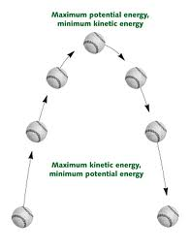
KE vs PE

Slide 7
EX:
You lift a 7.3 kg bowling ball from the storage rack and hold it at your shoulder. The rack is 0.61 m above the ground and your shoulder is 1.12 m.
A) At your shoulder, what is the ball’s GPE relative to the floor?

Slide 8
B) At your shoulder, what is the ball’s GPE relative to the rack?
C) How much work was done by gravity as you lifted the ball?

Slide 9
Elastic Potential Energy
The potential energy that may be ____________ in an object as a result of a _________________________
EX: bow and arrow, rubber balls, trampolines, pole-vaults

Slide 10
11.2 Conservation of Energy

Slide 11
Law of Conservation of Energy
In a closed, isolated system, energy _______________________________
Energy can _________________________ ___________________________, but the ____________________ of the system remains _________________.

Slide 12
Mechanical Energy
The __________ of the KE and GPE of a system.
Conservation of ME
KE_{initial} + PE_{initial} = KE_{final} + PE_{final}
Holds as long as there are ______________ _______________________ in the system.
EX:

Slide 13
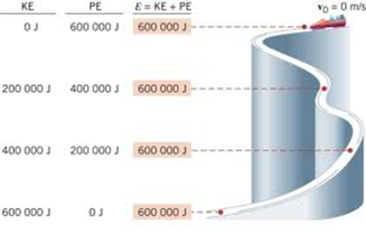

Slide 14
http://www.physicsclassroom.com/mmedia/energy/ce.cfm

Slide 15
In real-life ME is…
“Lost” due to:
______________________
______________________
______________________
Converted to:
______________________
______________________
http://www.youtube.com/watch?v=BVxEEn3w688

Slide 16
EX:
A large tree branch, with a mass of 22 kg and a height of 13.3 m above the ground, falls on a roof that is 6 m above the ground.
Ignoring air resistance, find the KE of the branch when it reaches the roof.
What is its speed when it reaches the roof?

Slide 18
EX:
A 50 kg skier starts from rest at the top of a 30 m hill. If the velocity of the skier at the bottom of the hill is 20 m/s, how much energy was lost from skiing down the hill?

Slide 20
Collisions
In an isolated system, _______________ __________________ are conserved in a collision.
However, energy may be ____________ ____________________ forms.

Slide 21
Case 1: KE increases after collision
Another form of energy in the system must have __________________
EX: a compressed spring is released converting PE to KE
Super elastic or explosive collision
http://www.youtube.com/watch?v=Gh2EdiZAvNg

Slide 22
Case 2: KE remains the same after collision.
Occurs between hard materials that can __________________ of each other.
EX: pool balls
Elastic collision
http://www.youtube.com/watch?v=IIwC1cKlaGo

Slide 23
Case 3: KE is decreased after collision
Some of the energy is converted to ______________________________.
Occurs between objects that can _______________________ together.
EX: Two cars crash and stick together
Inelastic collision
http://www.youtube.com/watch?v=e1IJUNW7Kq4&list=PLDD1DF2631B5A1EAD

Slide 24
EX:
A 54.5 kg ice skater moving at 3.2 m/s collides with a 44.7 kg skater who is motionless. They slide together along the frictionless ice.
What is their velocity after the collision?
How much KE was lost in the collision?

