Slide 1
Chapter 10: Energy and Work

Slide 2
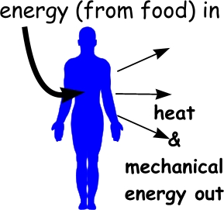
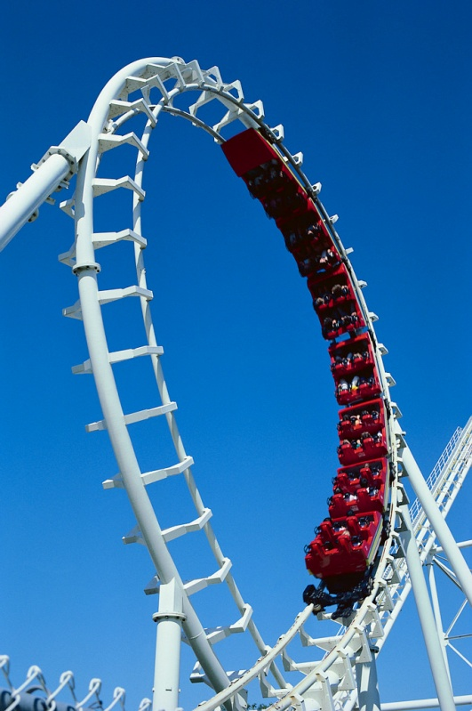
Energy
Energy – the ability of an object to ______________________ in ________ or the ____________________.

Slide 3
Energy
Kinetic Energy – energy associated with __________________________________.
This equation is a result of ____________ ____________ and the _______________ equations.

Slide 4
Work
Work – the process of ____________________ of a system by exerting a _________________ ___________________.
EX:

Slide 5
Work
Work – Energy Theorem – ____________ done on a system ______________ to the _________________ ______________________________
NOTE: The work-energy thm only holds when the ____________________ on a system is taken into account.
+W:
-W:

Slide 6
Explain Each in terms of the Work – Energy Theorem:
Pushing a box so that it accelerates across the floor
Pushing against a wall
Pushing at a constant speed
Lifting at a constant speed
A book in free fall

Slide 7
Work
Only the _________ or ____________ ________________ that is in the ____________________as the ________________ does __________ _________ on the object
Ɵ represents the angle between the __________ and the ______________

Slide 8
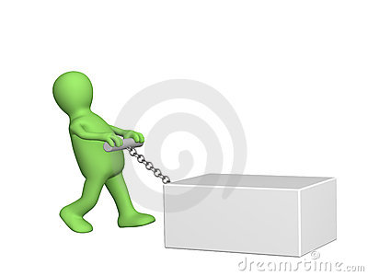
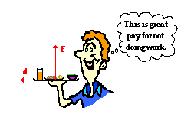
1. Force is in the same direction as displacement:
2. Force is at an angle to the displacement – only the ________________________of the force does work:
3. Force is ___________to the displacement:

Slide 9
Units
Unit for work and energy:
Joule – how much work it takes to move 1 Newton a distance of 1 meter.
EX: It takes 1 Joule of work to move an apple 1 meter.

Slide 10
EX:
A 60 kg runner has 1920 J of kinetic energy. At what speed is she running?

Slide 11
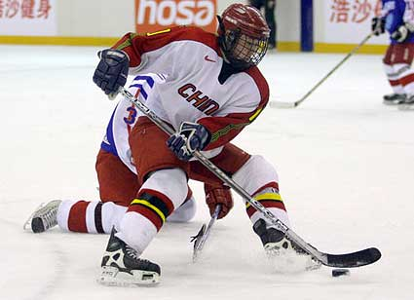
EX:
A 105 g hockey puck at rest on ice. A player exerts a constant 4.5 N force over a distance of 0.15 m. How much work does the player do on the puck? What is the change in the puck’s energy? What is the final velocity of the puck?

Slide 13
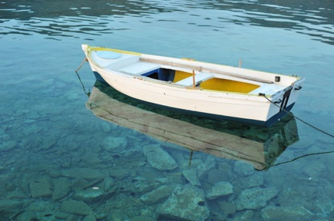
EX:
A sailor pulls a boat 30 m along a dock using a rope that makes a 25 degree angle with the horizontal. How much work does the sailor do on the boat if he exerts a force of 225 N on the rope?

Slide 15
Power
Power – the __________ of doing __________
Power takes into account how _____________ a certain amount of work is done
The ____________ you can do a certain amount of work, the _______________________you have

Slide 16
Power
Units:
EX: You lift a glass of water to your mouth in 1 second, you are doing work at a rate of 1 watt (you have a power of 1 watt)
A watt is small, so a ______________________ is more practical and more commonly used.

Slide 17
EX:
An electric motor lifts an elevator 9 m in 15 s by exerting an upward force of 1.2x10⁴ N. What power does the motor produce in watts and kilowatts?

