Slide 1
10.2 Machines

Slide 2
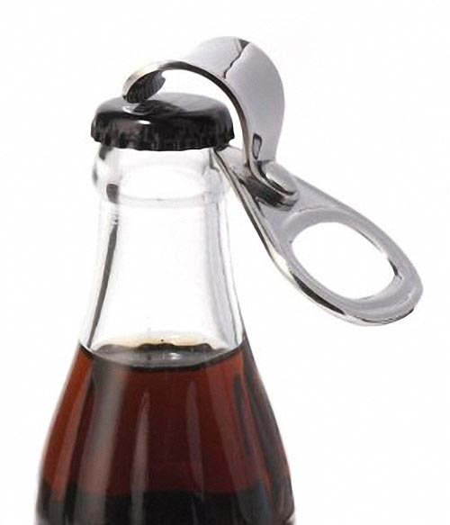
Machine: a tool used to ________________.
Machines make work easier to do by providing some trade-off between the ____________________ and the _____________ _______________________________________.
They change the size or the direction of the applied force.
EX: Bottle opener

Slide 3
Terms and Equations
Effort Force (F_{E}):
Effort Distance (D_{E}):
Work Input (W_{I}) – work done on a machine

Slide 4
Resistance Force (F_{R}):
Resistance Distance (D_{R}):
Work Output (W_{O}) – work done by a machine

Slide 5
Machines
Machines can _______________________.
Machines do not _____________________.
Work output cannot be greater than work input.
Ideal Work:
Mechanical Advantage (M.A.) – the number of times a machine ______________ the _________________.

Slide 6
Mechanical Advantage = F_{R}/F_{E}
M.A. equal to 1:
machine does not multiply the effort force, it just _________ ________________________ of the effort force.
EX:
M.A. is less than one:
machine __________________________ an object is moved.
EX:
M.A. greater than one:
machine ________________________applied by the person.
EX:

Slide 7
Mechanical Advantage:
M.A. =
Ideal M.A. =

Slide 8
Efficiency of a machine:
The comparison of __________________ to ___________________
Expressed as a _______________
Can never be greater than ___________
Ways to increase the efficiency of a machine:
Reduce _____________________

Slide 9
Efficiency of a machine
% Efficiency =
Example: What is the efficiency of a machine where work input is 200 J, and work output is 100 J ?

Slide 10
Compound Machine
A machine consisting of _______________ ____________________ linked in such a way that the ________________________ __________________________________.
EX: Bike
MA/IMA of a compound machine is the _______________ of the MAs/IMAs of the simple machines.

Slide 11
Lever
A lever is a stiff rod that rotates around a __________________.
Depending on where the pivot point is located, a lever can either change the ______________ ________________ or the ________________ over which the force is applied.

Slide 12
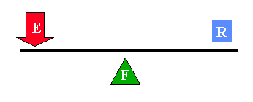
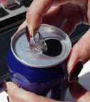
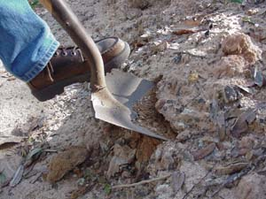
1st Class lever

Slide 13
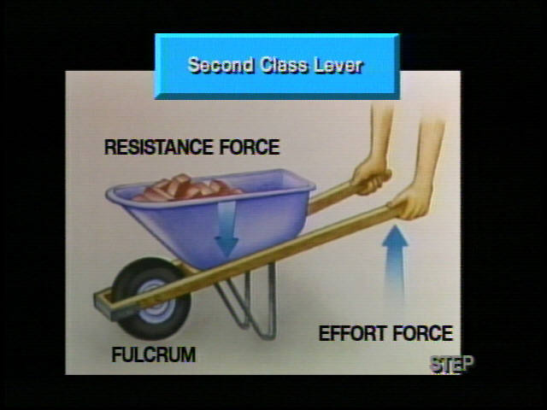
2nd Class lever

Slide 14
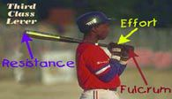
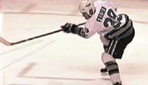
3rd Class Lever

Slide 15
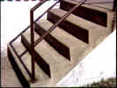
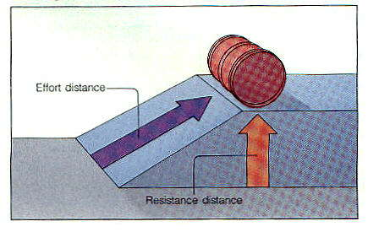
Inclined Plane
An inclined plane is a ____________ used to ______________________ an object up/down.

Slide 16
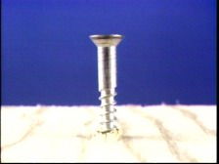
Screw
An _______________ wrapped to form a spiral
It reduces _______________ by increasing _____________________.

Slide 17
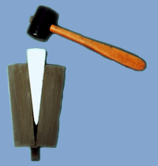
Wedge
A wedge converts motion in __________ ______________ into a splitting motion that acts at _________ ____________ to the blade.

Slide 18
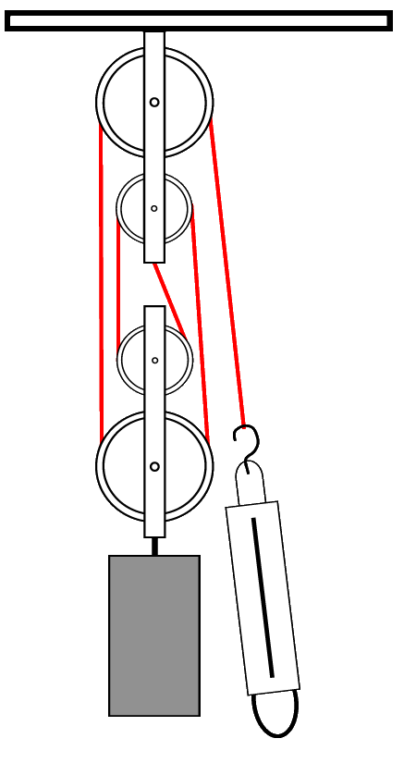
Pulley System
A single pulley simply ______________ ______________________ of a force.
When _________________pulleys are connected together, they permit a heavy load to be lifted with _________________ by _____________ ____________________.
The __________ of a pulley system is approximately equal to the __________ ________________________________.

Slide 19
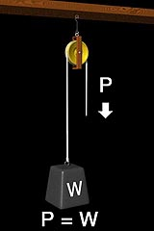
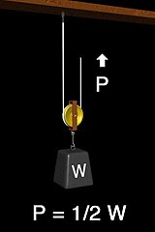
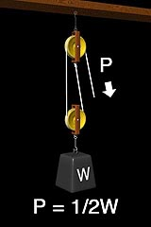
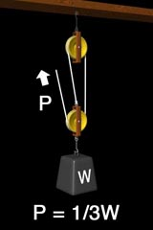
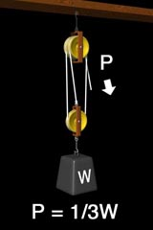
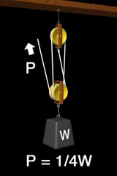
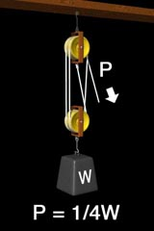
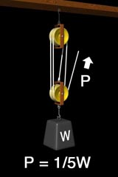

Slide 20
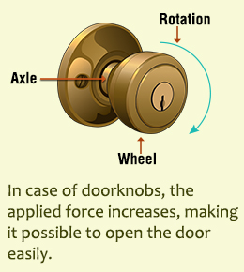
Wheel and axle
A wheel with a rod, called an axle, through its center that lifts or moves loads.

Slide 21
EX: The rear wheel on your bike has a radius of 35.6 cm and has a gear with a radius of 4 cm. When the chain is pulled with a force of 155 N, the wheel rim moves 14 cm. The efficiency of this part of the bike is 95%.
a) What is the IMA of the wheel and gear?
b) What is the MA of the wheel and gear?
c) What is the resistance force?
d) How far was the chain pulled to move the rim 14 cm?

